Slide 1

Teaching Resources and Instructors’ Guidelines
Chapter 15: Capturing learning from innovation

Slide 2
Chapter 15: Capturing learning from innovation
In the following PowerPoint slides you will find the key headings from CHAPTER 15 together with the main illustrations, tables, etc.
There are also slides summarizing the key messages in bullet-point fashion, and a wide range of activities which you can use to help students explore around these themes.
Finally there are some reflection questions which can be used as the basis for discussion or assignments.

Slide 3
Learning objectives
By the end of this chapter you will have:
Reviewed and consolidated the key themes in the book.
Explored key influences on how to manage the innovation process effectively.
Identified key skills at individual, team and organizational levels associated with effective innovation.
Developed the ability to review how well individuals and organizations manage the process.
Practised taking an audit approach to improving innovation and entrepreneurship.

Slide 4

Core themes and material from the book

Slide 5
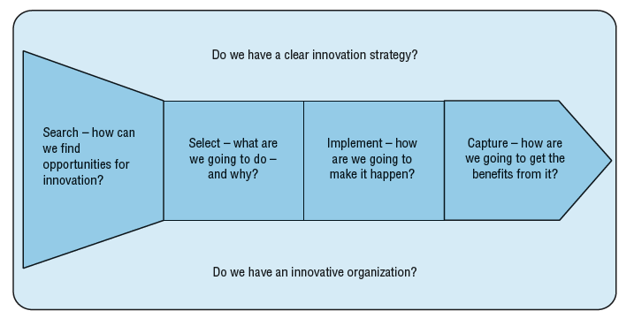
Core model of the process

Slide 6
Key themes
Innovation as a process
Patterns of behaviour which become embedded in routines – structures, procedures, policies – for making innovation happen
Varies between organizations – particular culture – ‘the way we do things round here’

Slide 7
Successful innovation…
is strategy-based;
depends on effective internal and external linkages;
requires effective enabling mechanisms for making change happen;
only happens within a supporting organizational context.

Slide 8
The ability to review and change the way innovation is managed.
Dynamic capability

Slide 9
We need to:
capture and reflect on our experiences, trying to distil patterns from them about what does and does not work
create models of how the world works (concepts) and link these to those we already have
use our revised models to engage again in innovation – trying new things out.
Learning to manage innovation

Slide 10
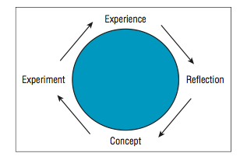
Kolb’s learning cycle

Slide 11
Aids to learning
Rather than simply stepping back for a reflective pause we could employ some structured question frameworks. And we could ask others to help us in the process, acting as critical and challenging partners to help us learn.
We can develop our own concepts, but we can also use, adapt and try out new ideas developed elsewhere. The ‘theory’ of innovation has emerged from many experiences codified into a rich body of knowledge and this is available to draw upon. We don’t have to reinvent the wheel.
Similarly, we don’t have to make all the mistakes ourselves. We can learn from other’s experiences

Slide 12

The value of failure
Provides insights about what not to do
Failure helps build capability
Failure helps others learn and build capability
So how to learn?

Slide 13
Approaches to enable learning
Post-project reviews
Procedural learning
Agile innovation
Benchmarking
Capability/maturity models
Innovation auditing

Slide 14
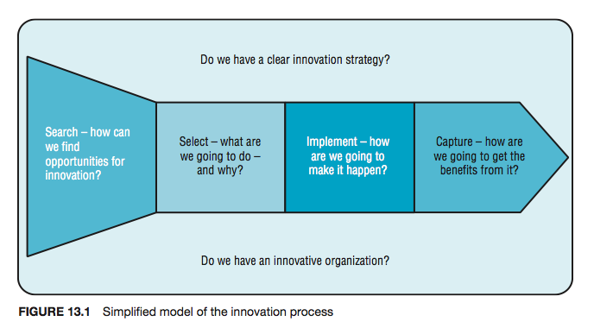
Core framework for reflection

Slide 15
The Innovation Fitness Test
Offers a framework of questions to explore these issues
What do low scores mean?
What can be done improve performance in these areas?
Offers opportunities for learning from others and ‘splicing’ in useful routines

Slide 16
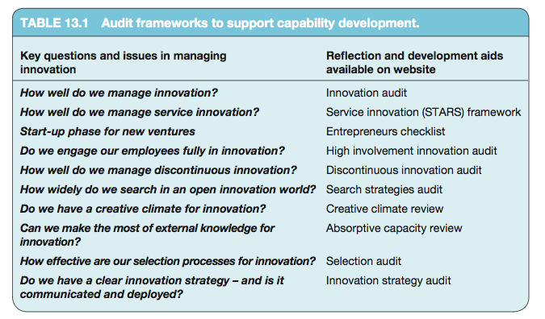
Audit frameworks to help reflect and learn

Slide 17
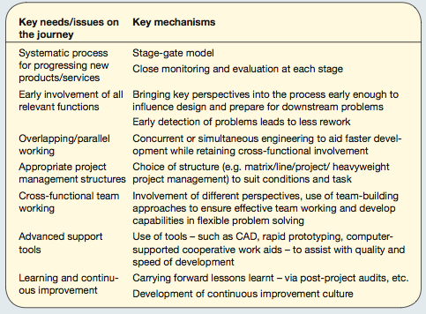
Success routines

Slide 18
Innovation strategy
A clear roadmap for change
Does the innovation we are considering help us reach the strategic goals (for growth, market share, profit margin – or changing the world in some way through creating social value, etc.) which we have set ourselves?
Do we know enough about this to pull it off (or if not do we have a clear idea of how we would get hold of and integrate such knowledge)?

Slide 19
Components of an innovative organization
• shared vision, leadership and the will to innovate
• appropriate structure
• identifying and supporting key individuals
• effective team working
• high involvement innovation
• creative climate
• external focus.

Slide 20
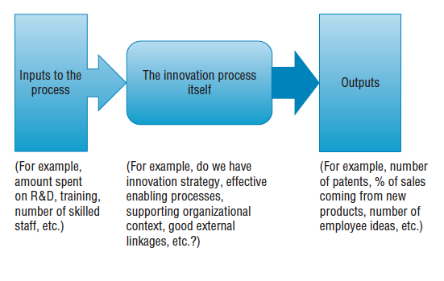
Measuring innovation

Slide 21
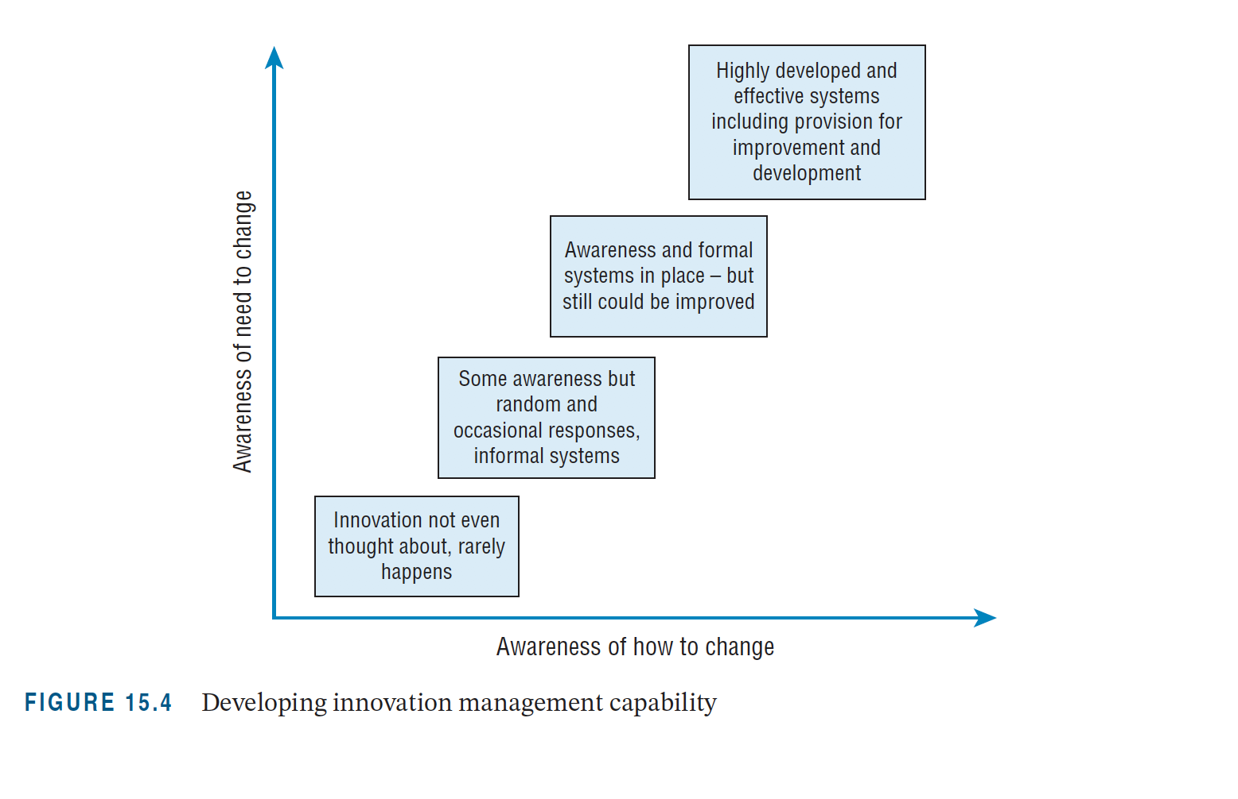
Developing innovation management capability

Slide 22
open innovation and the changing landscape for searching
user innovation and the growing importance of active stakeholder involvement in innovation
discontinuous innovation – learning to cope when the underlying rules of the game are changing
developing and emerging economies and the way the innovation game is changing as these places become the central focus for economic and social growth
social innovation – where the core motivation for change becomes improving well-being
sustainability-led innovation – where the question of how we deal with the resource, energy and environmental challenges of living on the planet take centre stage.
Challenges and need to develop capability

Slide 23
Summary
Wherever innovation happens – big firm, small firm, start-up business, social enterprise – one thing is clear: successful innovation won’t happen simply by wishing for it. This complex and risky process of transforming ideas into things which make a mark needs organizing and managing in strategic fashion.

Slide 24
Summary
A wide range of structures, tools and techniques exist for helping think about and manage the core elements of the innovation process. The challenge is to adapt and use them in a particular context – essentially a learning process.
The major requirement is for a commitment to undertake such learning, but it can also be enabled by the use of tools and reflection aids. In particular, the chapter looks at various approaches to innovation auditing and offers some templates for reviewing and developing capability across the process as a whole and in particular key areas.
At the heart of such audit approaches are some key questions:
  Do we have a clear process for making innovation happen and effective enabling mechanisms to support it?
  Do we have a clear sense of shared strategic purpose and do we use this to guide our innovative activities?
  Do we have a supportive organization whose structures and systems enable people to be creative and share and build on each other’s creative ideas?
  Do we build and extend our networks for innovation into a rich open innovation system?

Slide 25

Videos
There are several videos which can help explore and present the key themes of the chapter:
Learning and building capability
Interviews with practising innovation managers
Frontiers in innovation management – interview with John Bessant on future challenges
Notes:
Short videos

Slide 26
Videos
Astro Teller’s TED Talk, ‘The unexpected benefit of celebrating failure’
https://www.ted.com/talks/astro_teller_the_unexpected_benefit_of_celebrating_failure
David Teece discussing Dynamic Capabilities and Strategic Management
And a sideways look at dynamic capability from John Bessant

Slide 27
Podcasts and blogs
There are several podcasts here and blogs here which pick up themes in the chapter. These include:
Cultures of innovation
Crisis-driven innovation
If at first you don’t succeed…
Getting fit for innovation
Some lessons from the ‘Hundred Club’

Slide 28
Cases
There are several case studies which pick up themes raised in the chapter – you can find them here.
In particular:
Benchmarking in the automobile industry – shows how systematic comparison enabled learning and capability development around the emergent model of ‘lean manufacturing’
Coloplast – detailed case showing how a company used an audit approach to review and build innovation capability
Hella – another in depth example applying the framework used in this chapter
3M, Kao, Corning and Electroco mapped against the chapter framework for reviewing innovation management
Cerulean and its use of an audit approach to assess creativity within the organization
More than just luck – a review of how well agencies in the humanitarian field mange the process

Slide 29
Activities
There are several activities designed to help explore themes raised in the chapter. You can find a full list here.
In particular:
Sector innovation patterns
The way we do things round here
Success and failure in innovation
Identifying innovation capabilities
Innovation fitness test
Innovation management project

Slide 30
Activity: Innovation fitness review
Ask students to research an organization and try and assess how well it manages innovation using the framework offered in the Innovation Fitness Test. They should prepare a presentation summarizing their analysis and recommendations.

Slide 31
Activity
Using one of the innovation audits on the website review a case of an organisation and develop a perspective on how well you think they manage innovation? Why? And where do they need to concentrate their development efforts to enhance their capability for the future?
(If you need a case to focus on there are several on the website – for example, Corning, Hella, Marshalls, Coloplast).

Slide 32
Activity: The ‘hundred club’
Carry out a critical review of the ways in which the 3M organization manages innovation. Some frameworks for this have been developed throughout the book, and the ‘innovation audit’ frameworks on the website provide a structured aid. Use this review to argue whether or not you think 3M will still be around for another hundred years?
You can pick any other examples of organizations which have been around for over 100 years – since they clearly have developed some effective innovation routines
This can be an individual reflection or a group review and presentation

Slide 33
Tools
These are all available here
Post-project reviews
Benchmarking
Agile innovation/lean start-up
Audit frameworks
  Innovation fitness test – framework for assessing how well an organization manages innovation?
  Service innovation (STARS) framework – how well do we manage service innovation?
  Entrepreneurs checklist - simple reflection framework to help assess capability at start-up phase for new ventures
  High-involvement innovation maturity audit – tool for assessing how well employees are engaged in innovation?
  Discontinuous innovation audit – framework similar to Innovation Fitness Test exploring how well do an organization manages discontinuous innovation
  Search strategies audit – framework to assess how widely an organization searches in an open-innovation world
  Absorptive capacity review – framework to explore how well placed an organization is to exploit external knowledge
  Creative climate – how to assess the organization
The KEYS approach
Ekvall’s climate survey

Slide 34
Assessment and discussion questions
1. Is innovation manageable – or just a random, gambling process? If it is manageable, what factors are important?
2. What lessons can we derive from studies of innovation success and failure about key principles on which to focus management attention?
3. If you were trying to ensure an innovation project had no hope of succeeding, what would you recommend?

Slide 35
Assessment and discussion questions
4. How can innovation be measured?
5. The Managing Director of your company has asked you to give her some clear guidance on what they should measure to ensure their investment in innovation is worthwhile. What would you suggest as possible measurement targets, and why?

Slide 36
Assessment and discussion questions
Use the reflection questions in this chapter (and additional ones from the online audit frameworks) to carry out a review of innovation management capability in an organization you are familiar with.
‘If we don’t learn from history, we are condemned to repeat it.’ This famous quotation underlines the challenge of learning. What stops organizations learning from their past efforts at innovation – and what can they do to improve their learning capability in the future?

